Slide 1
CSNE Testbeds-SDSU
04/30/13

Slide 2
Testbed #1
1) Closed-loop Prosthetic Limbs: The center is developing “smart” lower extremity prostheses that provide haptic feedback to the user and dynamically adjust to the terrain underfoot and the state of the user’s residual limb. Proposals that advance the state of the art in sensing, neural feedback strategies, or detection of user intent and conversion to control of powered prostheses are encouraged.

Slide 3
Closed-loop Prosthetic Limbs Block Diagram (overall)
E: Haptic Feedback - Motor intent is routed back into the peripheral nervous system for users
A: Peripheral Neural Interface - Detection of user intent from the motion or muscle
D: External Sensing System – Dynamically sense the terrain underfoot and the state of the user’s residual limb
C: Control of Powered Prostheses – Actuate wearable “smart” lower extremity prostheses
B: Peripheral Neural Signal Translation - Extract useful control commands in real-time

Slide 4
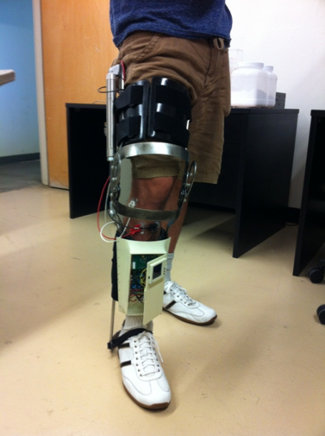
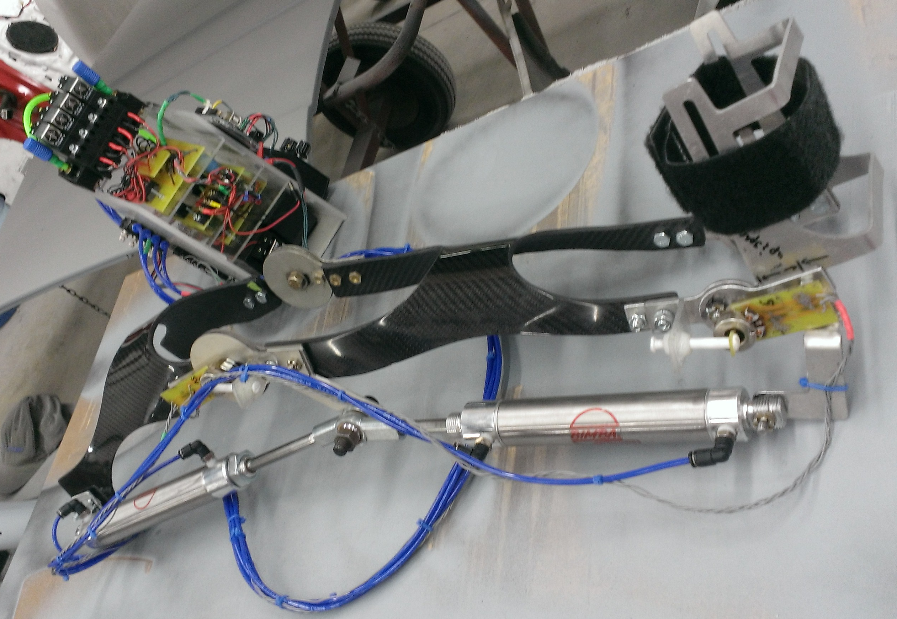
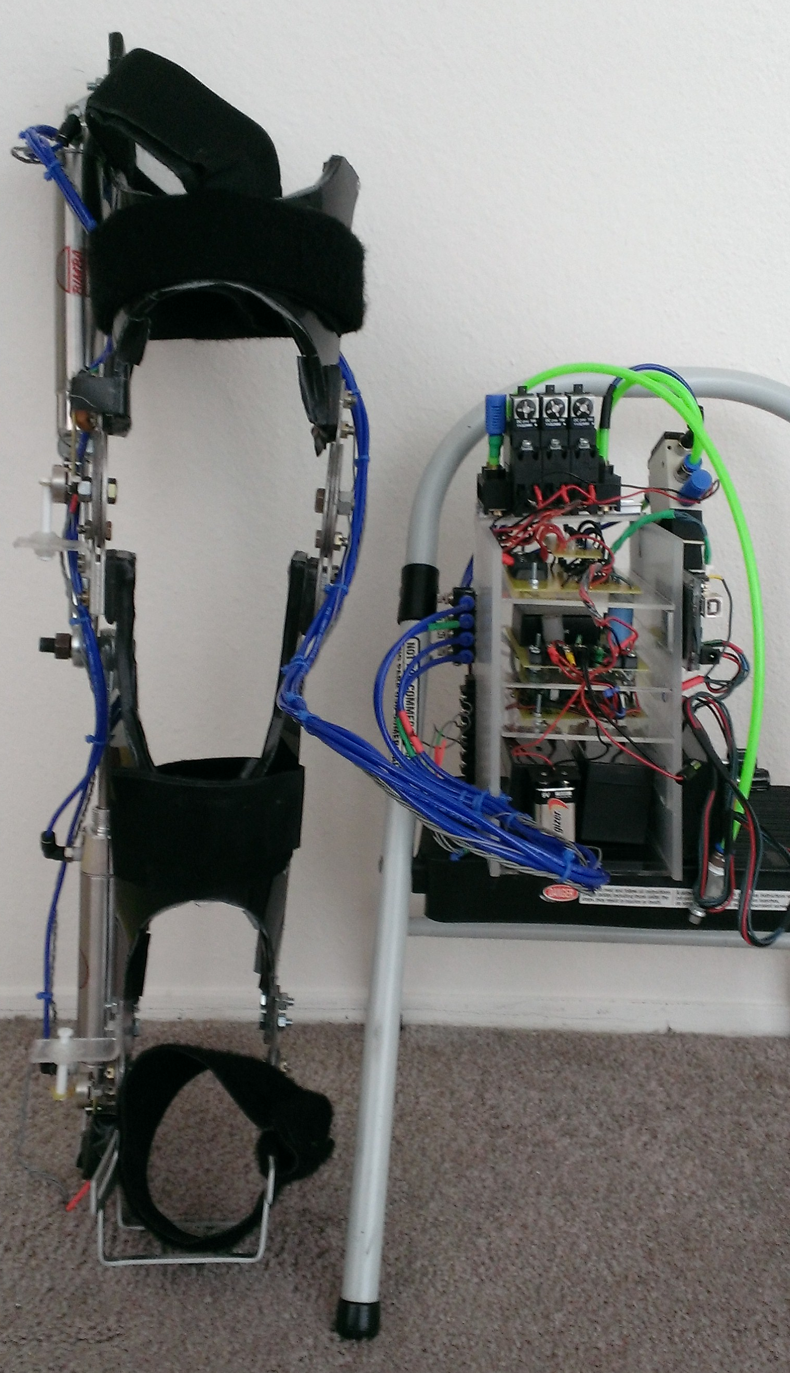
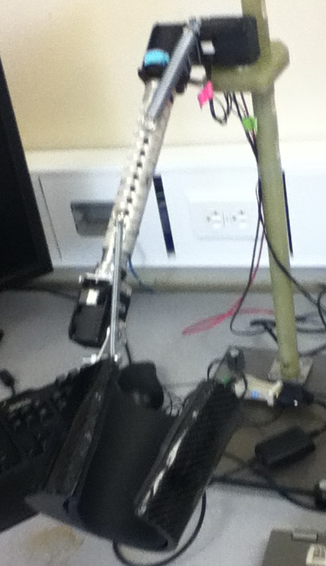
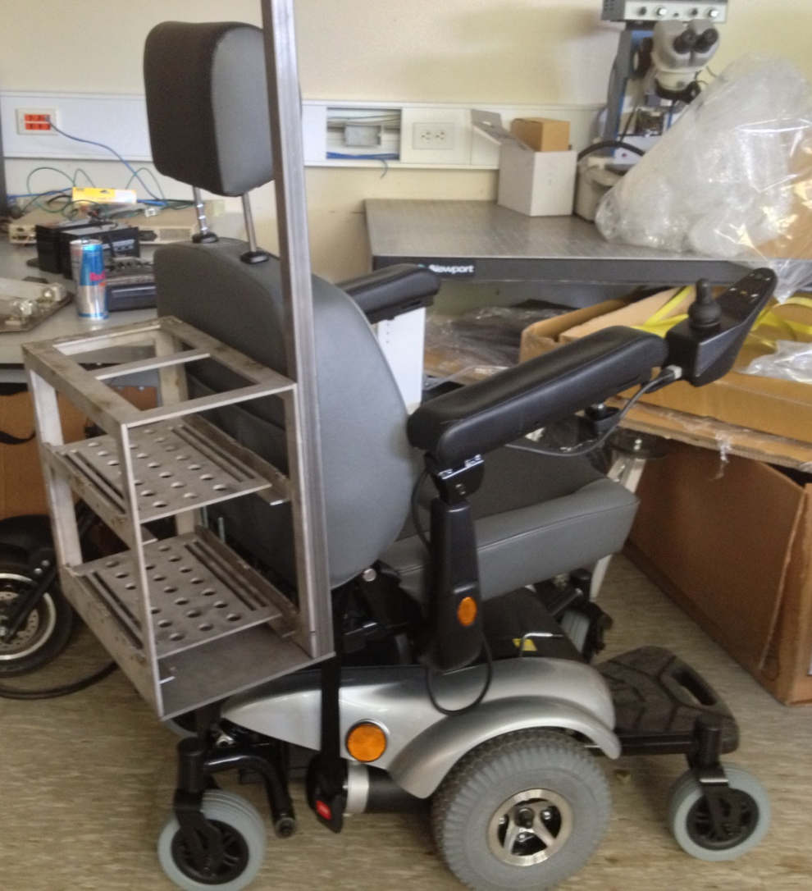
Wireless muscle and motion sensor
Neuro-adaptive Robotic Limbs - SDSU
Robotic assistive wearable brace
“Smart” wearable robotic arm:
a robotic arm to be attached to a motorized wheelchair, giving the user greater strength and mobility. operation.

Slide 5
Testbed #2
2) Neuro-rehabilitation Systems: The center is developing rehabilitation systems to improve function of the nervous system after injury or disease. Examples include EMG-driven computer games for rehabilitation of movement after brain injury, or augmented sensory feedback environments for users with impaired sensation. Proposals that advance neural signal sensing or sensory feedback technologies, human-computer interaction, and therapy strategies that leverage neuroplasticity to improve function are encouraged.

Slide 6
Neuro-rehabilitation Systems Block Diagram (overall)
E: Augmented Sensory Feedback - Motor intent is routed back into the peripheral nervous system for users with impaired sensation
A: Peripheral Neural Interface - Record (wirelessly) signals originating from the nerve or muscle
C: Therapy Control of Rehabilitation System - Actuate interactive/wearable rehabilitation devices
B: Peripheral Neural Signal Translation - Extract useful control commands in real-time
D: Game-based Rehabilitation - Computer games for rehabilitation of movement after brain injury

Slide 7
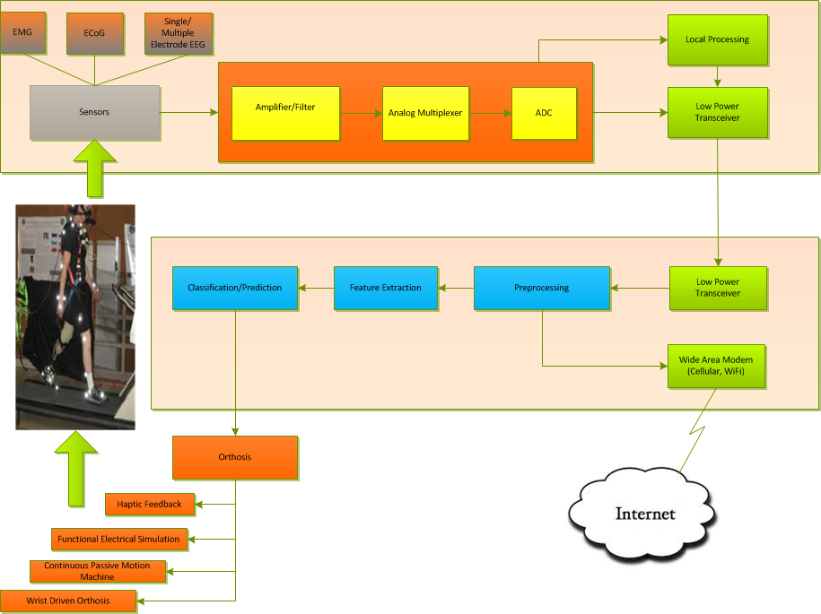

Slide 8
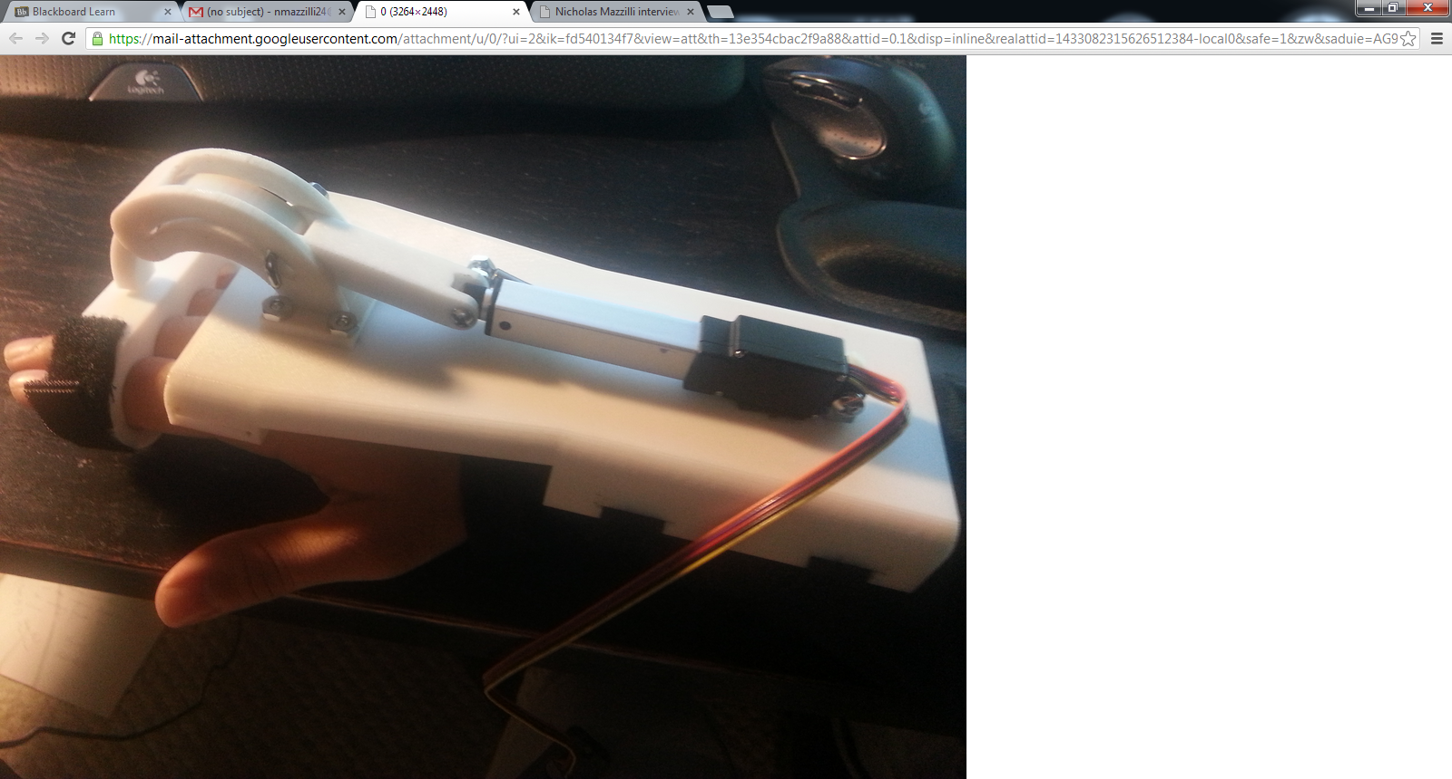
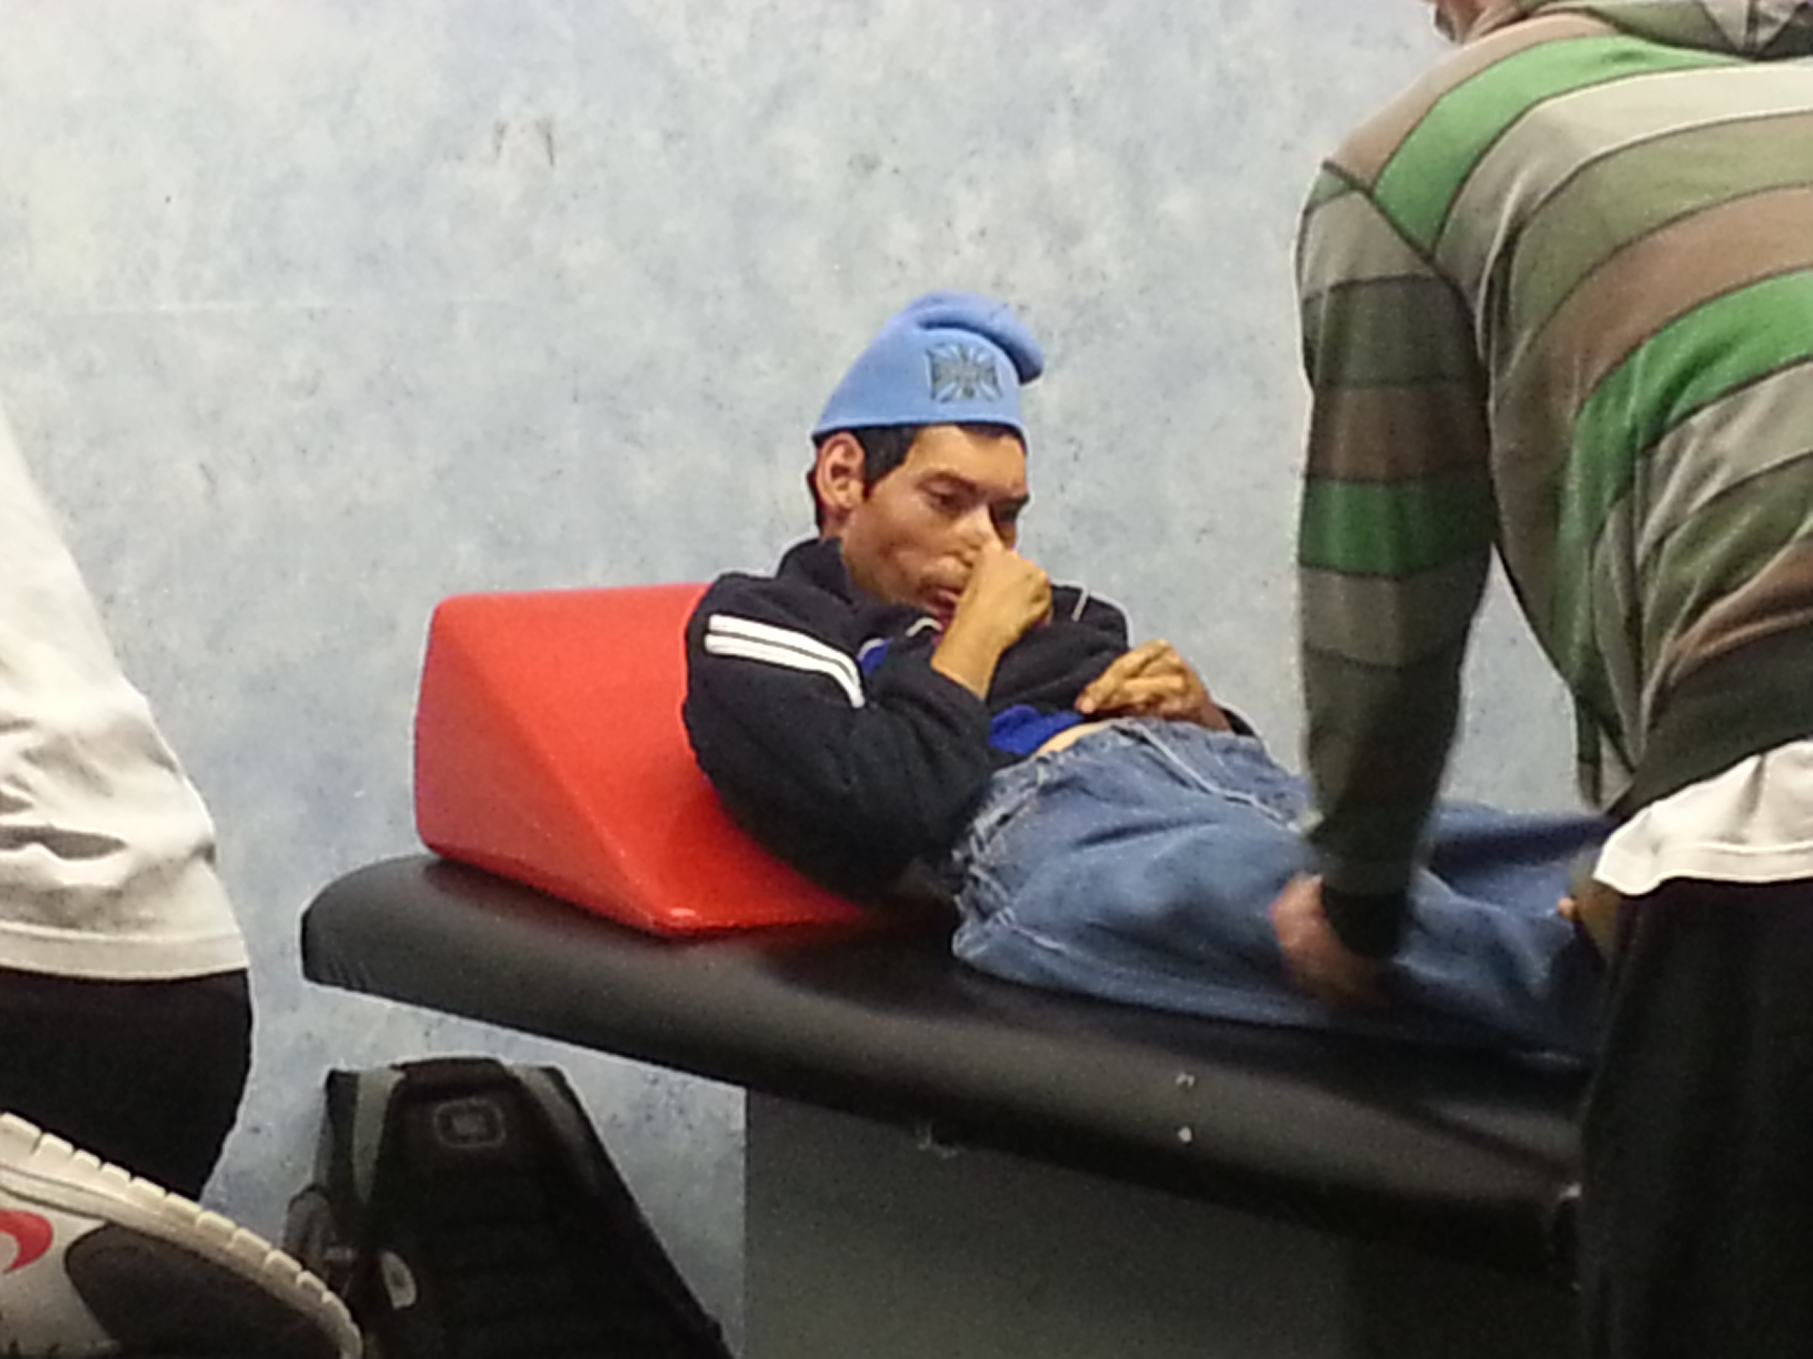
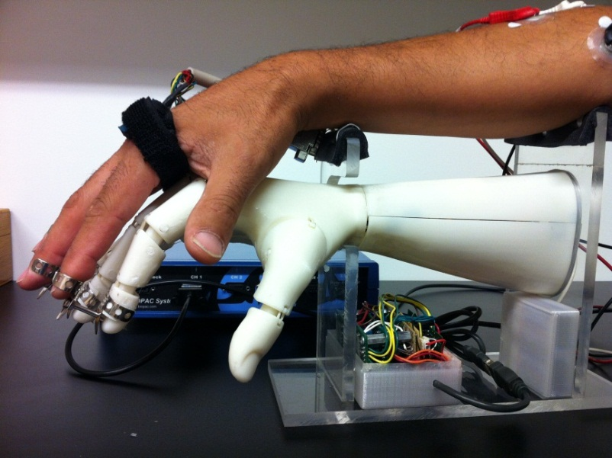
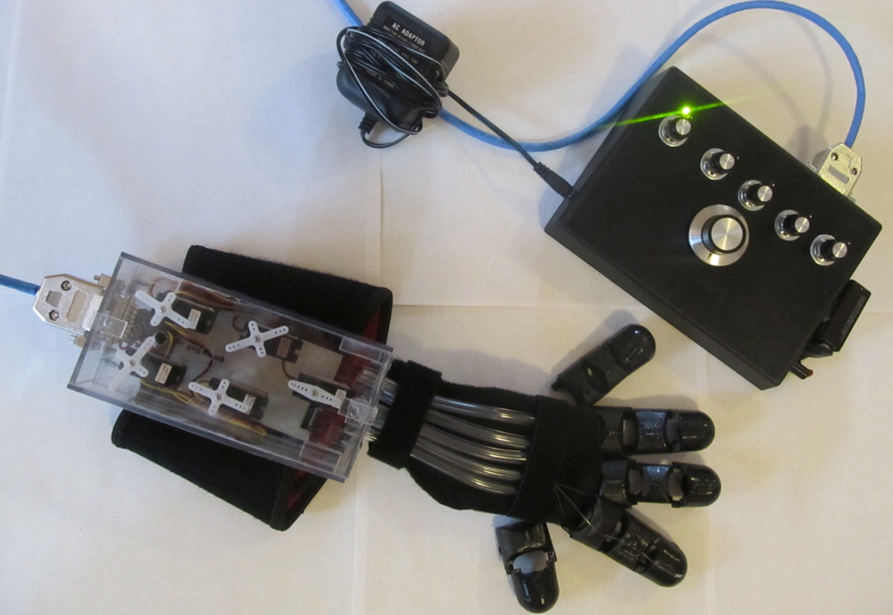
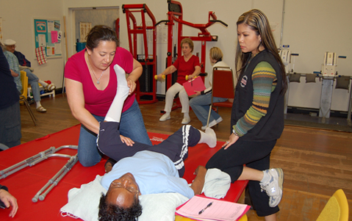
Neuro-Rehabilitation Systems - SDSU
SDSU Fitness Clinic for Neuro Rehabilitation
Wireless finger motion sensor with robotic rehabilitation device

